Slide 1
REVIEW 1. Understanding Supply

Slide 2
Define the Law of Supply.
The Law of Supply is the tendency of suppliers to offer more of a good at higher prices.

Slide 3
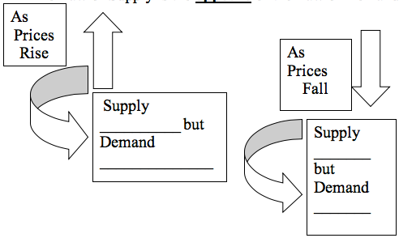
How does the Law of Supply differ from the Law of Demand?

Slide 4
How does the Law of Supply differ from the Law of Demand?
RISES
FALLS
FALLS
RISES

Slide 5
List two goods with inelastic supply.
In general, supply tends to be initially inelastic because it takes time to increase supply
Apples tend towards inelastic supply. It takes time to grow apples.
Trees would take even longer to be harvested for lumber

Slide 6
List two goods with elastic supply.
The supply of haircuts can be increased easily.
Taxi services. It is relatively easy for people to work as a taxi driver. People can work part-time and only need a qualified driving license.

Slide 7
Why does supply increase as price increase?
Supply increases as price rises because either existing firms will produce more to make greater profits…
Or new firms will enter the market to take advantage of the high prices.
Sellers love to make profits.

Slide 8
Why does it take time to increase supply?
Some products take time to grow or manufacture in order to replace what has been demanded.

